Slide 1

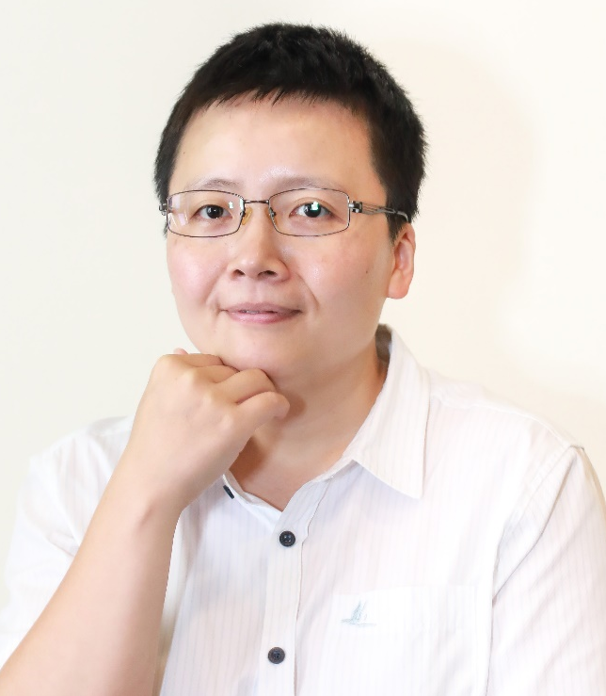
Med ai Evaluation
智慧醫療影像軟體之驗證評核與審查經驗分享
Prof Ching-Wei Wang
http://www-o.ntust.edu.tw/~cweiwang/
http://www.aiexplore.tw/
YouTube Channel: https://www.youtube.com/channel/UC7d-wG4DExSO1oZLBlo_qCg

Slide 2
Outline
Self Introduction 自我介紹
Evaluation Technology 驗證評核方法
AI in Medical Image Analysis 應用範例
Review experience sharing 審查經驗分享
Q & A

Slide 3
Self Introduction 自我介紹

Slide 4
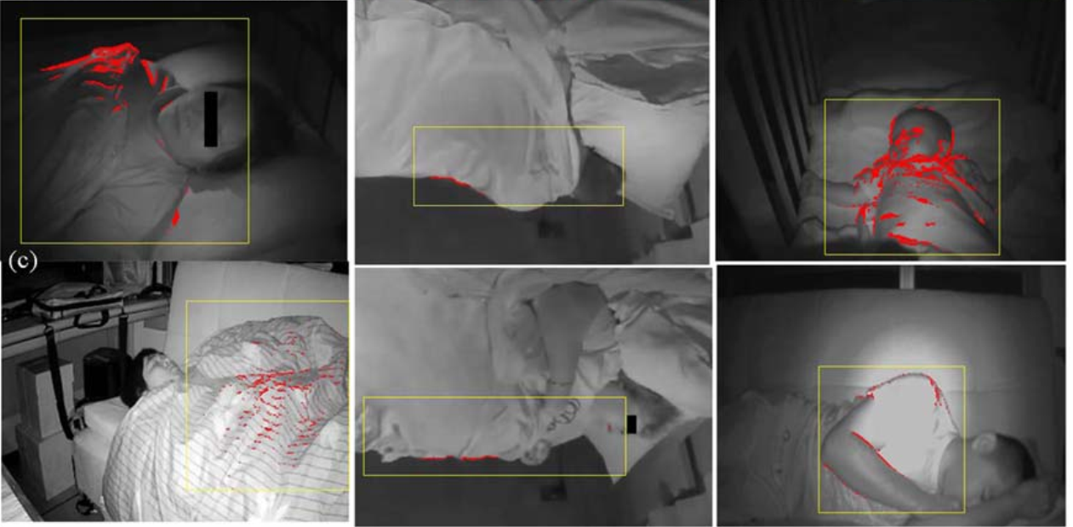
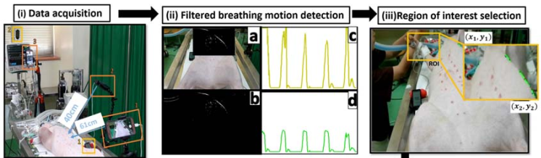
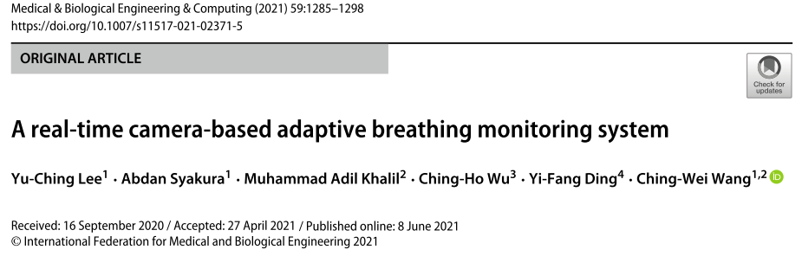
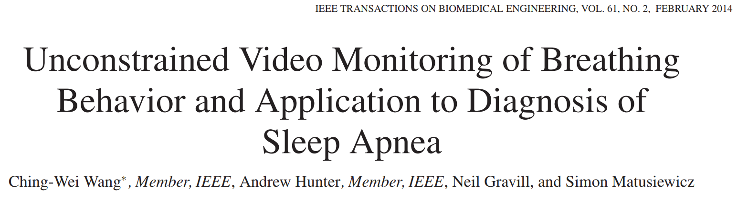
Prof Ching-Wei Wang 王靖維教授
· PhD in Computer Science, University of Lincoln, Lincoln, UK, 2005/12/1-2009/3/30 (英國衛生福利部全額獎學金) · Distinction MSc, IT(System and Software), University of Glasgow, Glasgow, UK, 2002/9/1-2003/9/1 (傑出畢業生) · BA, Business Administration, National Chengchi University, Taiwan, 1997-2001
· Researcher (2008/9~2009/9), Dept. of Medical Physics, United Lincolnshire Hospital, UK · Demonstrator (2006-9) Dept. of Computing & Informatics, University of Lincoln, UK(講師) · R&D FAE (2005/7~2005/11) Intervideo, Corel Corp., Taipei Branch, Taiwan · R&D Project Manager, Sr. Software Developer (2004/6 ~ 2005/7) InstekDigital, Taipei Headquarter, Taiwan · R&D Software Engineer (2003/6~2004/6) WaveTronex, Taiwan

Slide 5
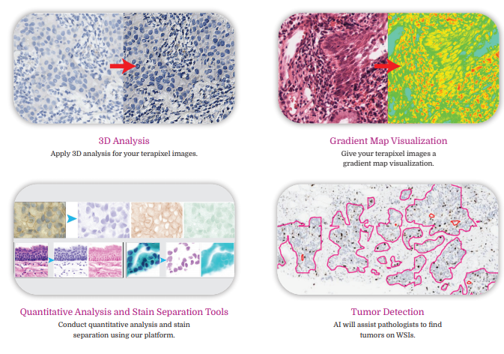
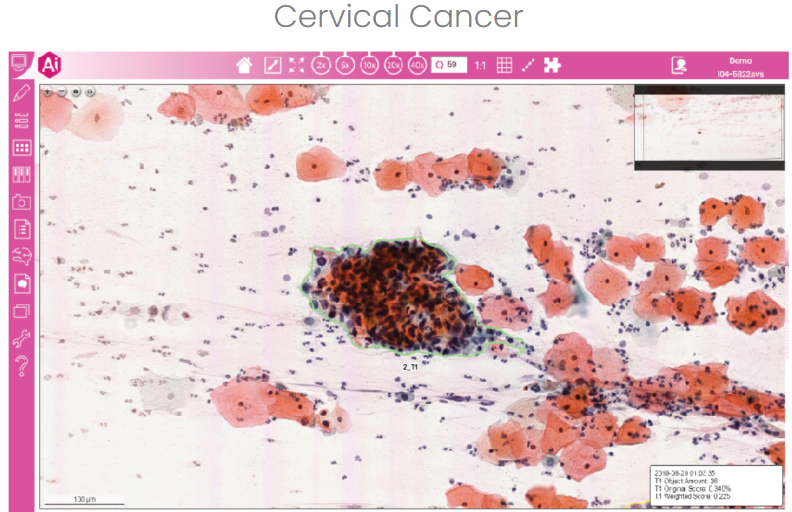
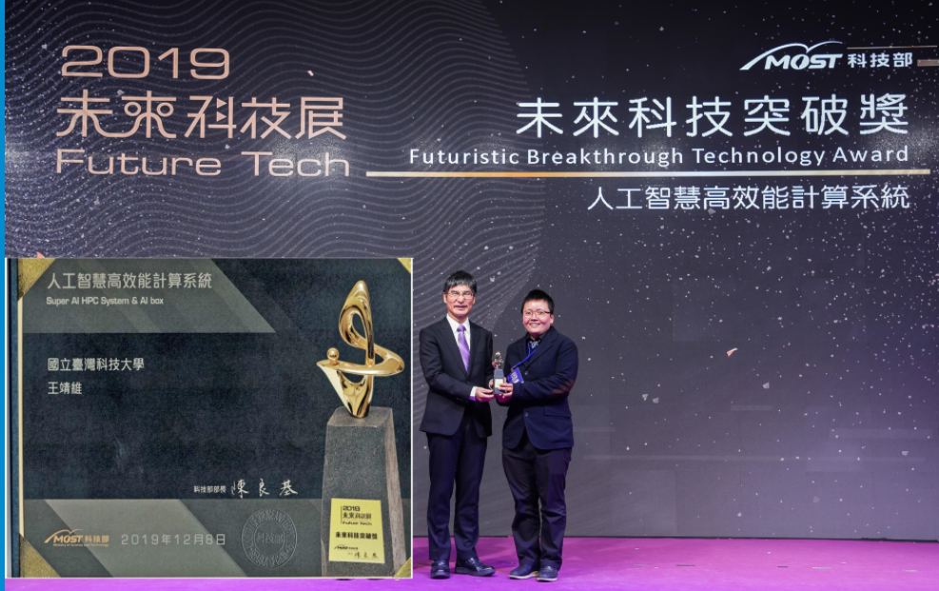
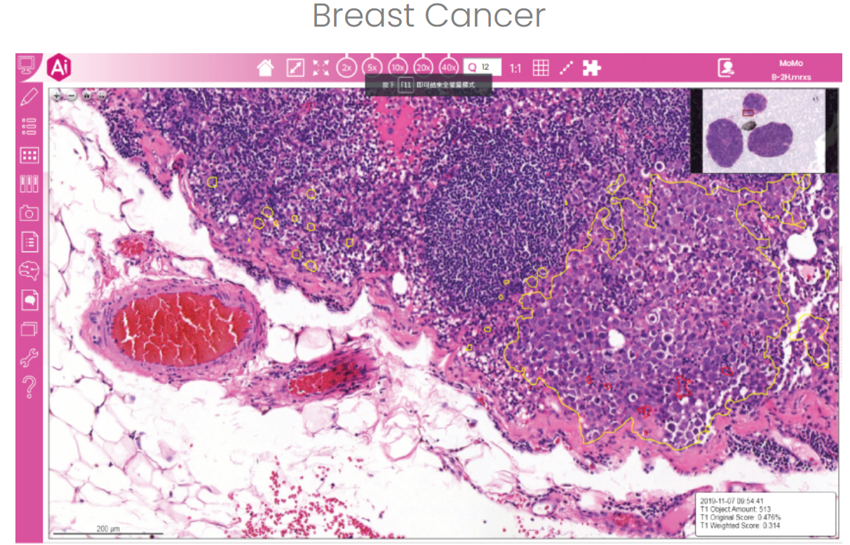
Prof Ching-Wei Wang 王靖維教授
· Medical Device Committee (2014~current) Taiwan Food and Drug Administration, Ministry of Health and Welfare. (衛福部食品藥物管理署TFDA 2014/1(103年度)-2017/12, 2021/1-2022/12 醫療器材諮議會委員)
· Professor (2017/8~) National Taiwan University of Science and Technology, Taiwan (正教授)
· Associate Professor (2013/8~2017/7) National Taiwan University of Science and Technology, Taiwan (副教授) · Assistant Professor (2010/8~2013/7) National Taiwan University of Science and Technology, Taiwan (助理教授)
· Research Fellow (2009/4/1~2010/7/1) Centre of Cancer Research & Cell Biology, Queens University Belfast, UK

Slide 6
國際Medi ai 驗證評核經驗

Slide 7
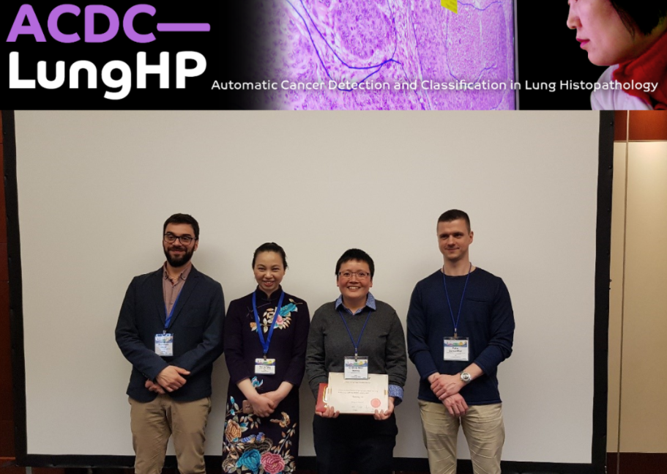
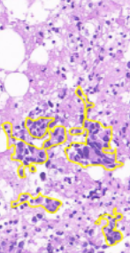
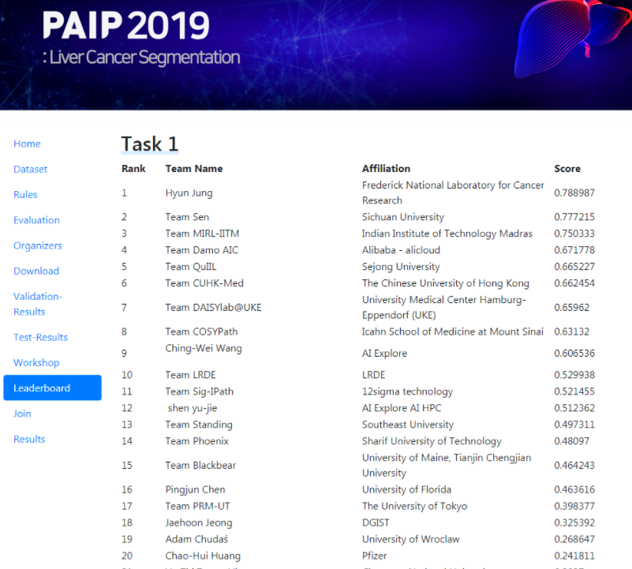
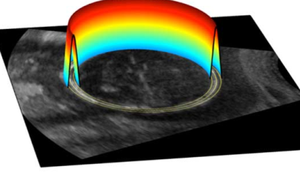
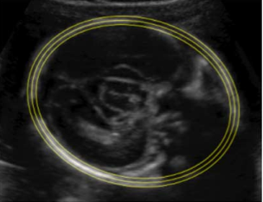
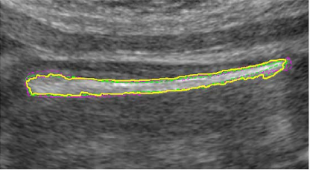
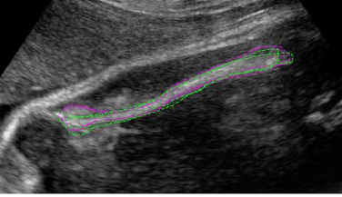
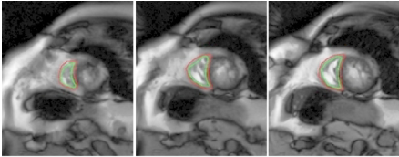
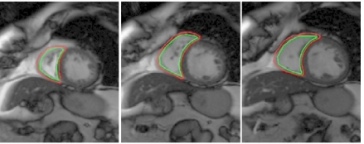
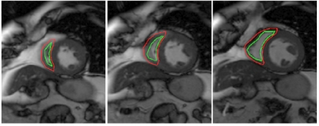
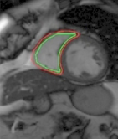
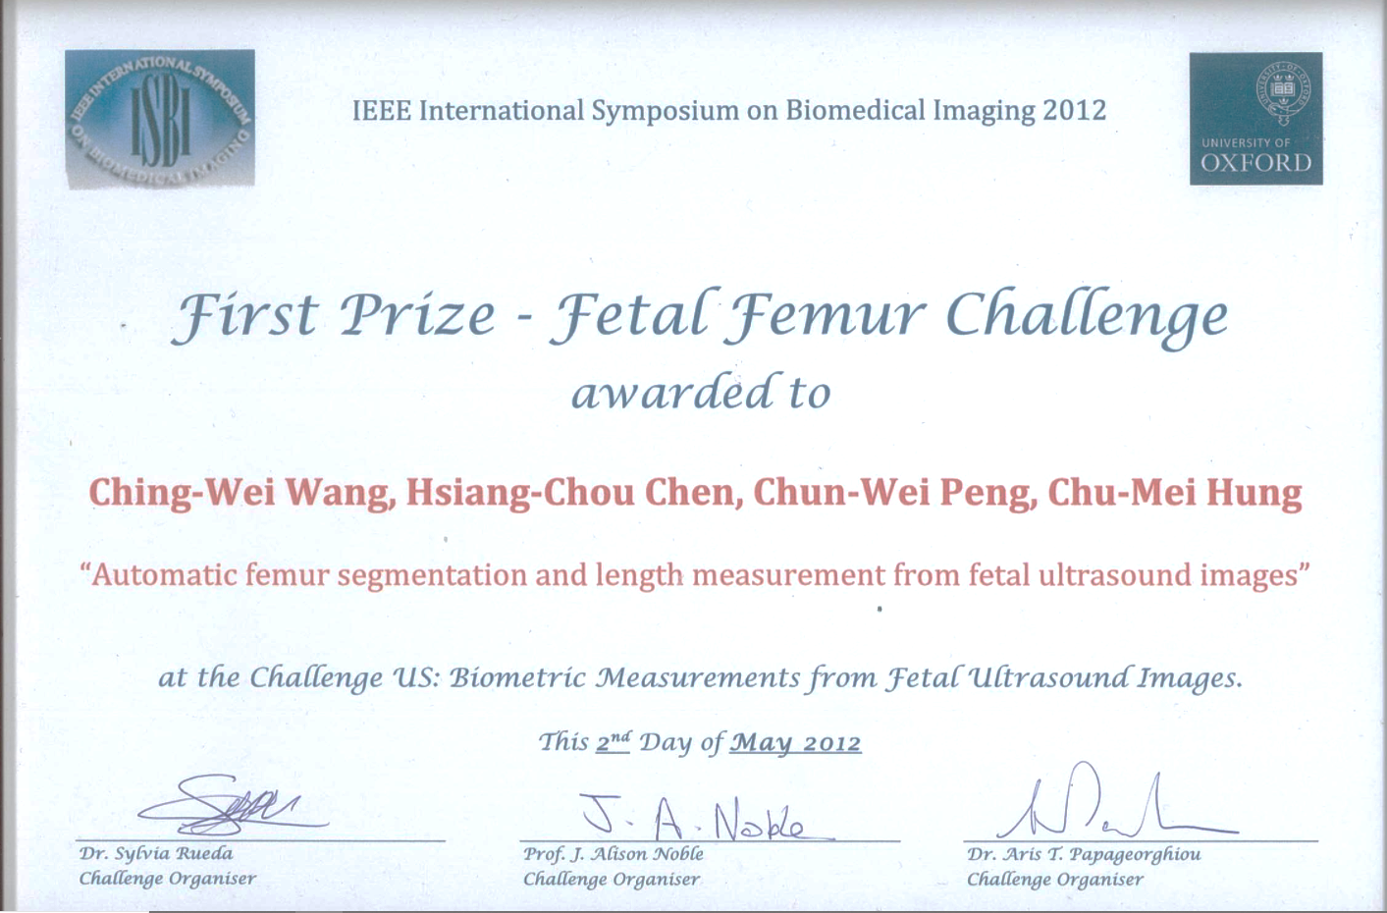
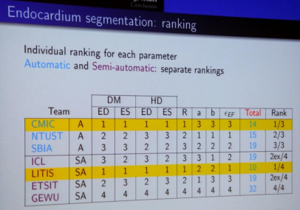
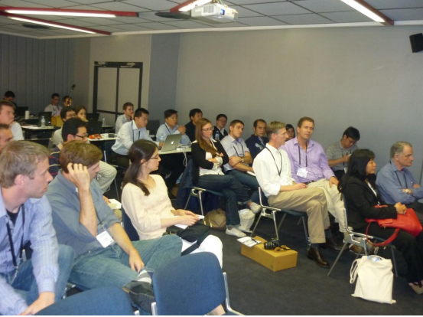
Med AI Challenge Award 國際 智慧醫療 競賽獲獎
2019 IEEE ISBI ACDC Automatic Cancer Detection and Classification in Whole-slide Lung Histopathology challenge, 世界第8名, Venice, Italy
2019 MICCAI Liver Cancer Segmentation challenge, 世界第9名, China
2012 MICCAI 國際4D心臟MRI醫學影像自動分析競賽第二名, Nice, France
2012 IEEE ISBI 國際超音波醫學影像自動辨識競賽第一名, 主辦:英國牛津大學, Barcelona, Spain.

Slide 8
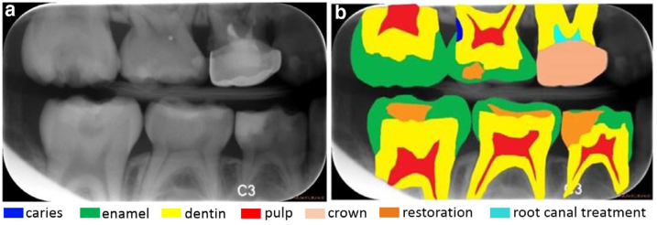
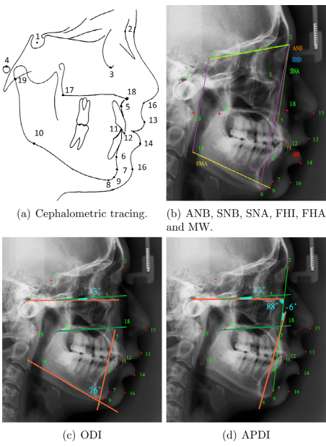
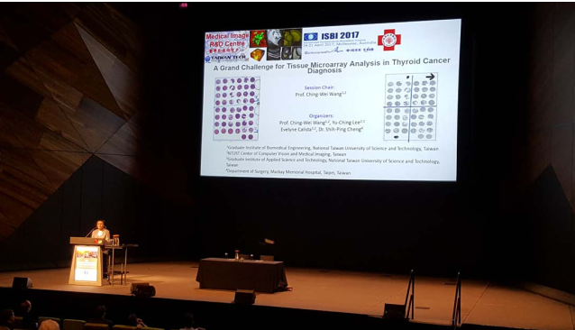
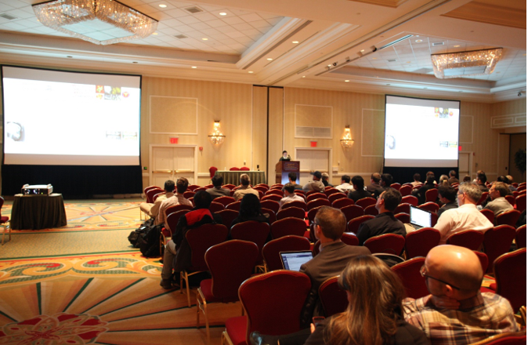
Host Med AI Challenge 主辦智慧醫療影像競賽
Chair of the Grand Challenge for Tissue Microarray Analysis in Thyroid Cancer Diagnosis, IEEE International Symposium on Biomedical Imaging 2017, Melbourne, Australia (主辦IEEE ISBI 2017國際醫學影像競賽, 墨爾本, 澳大利亞)
Chair of Grand Challenges in Dental X-ray Image Analysis, IEEE International Symposium on Biomedical Imaging 2015, New York, USA (主辦IEEE ISBI 2015國際醫學影像競賽, 紐約, 美國)
Chair of the Grand Challenge - Automatic Cephalometric X-Ray Landmark Detection, IEEE International Symposium on Biomedical Imaging (ISBI) 2014, Beijing, China (主辦IEEE ISBI 2014國際醫學影像競賽, 北京 中國)

Slide 9
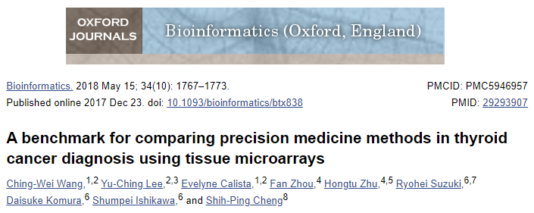
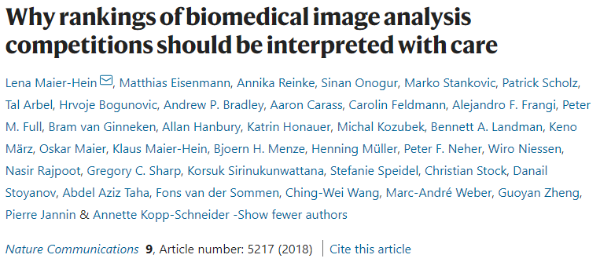
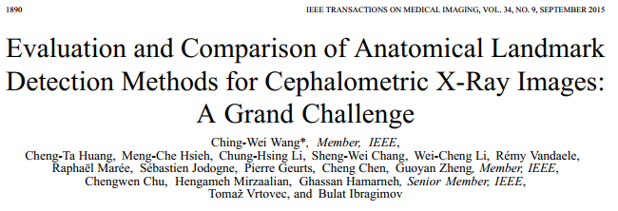
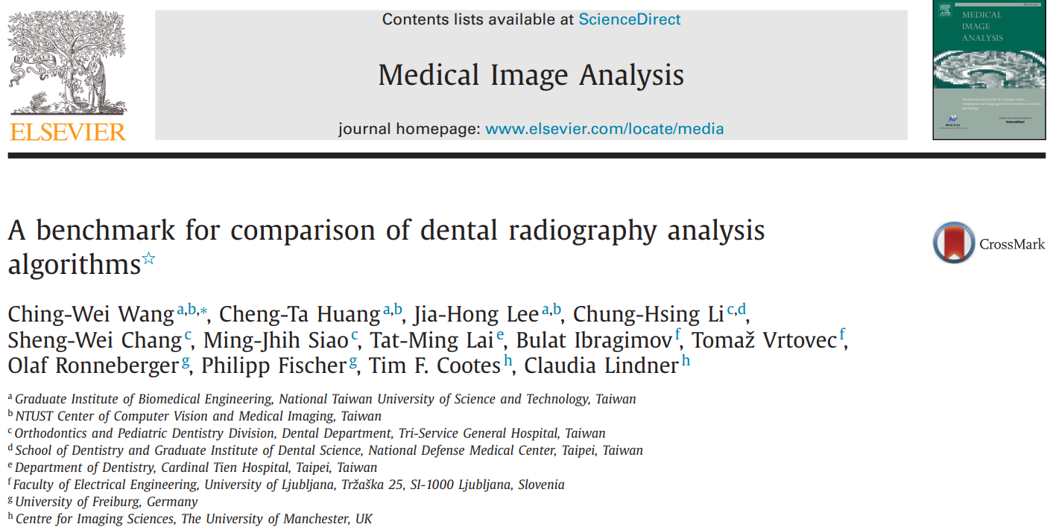
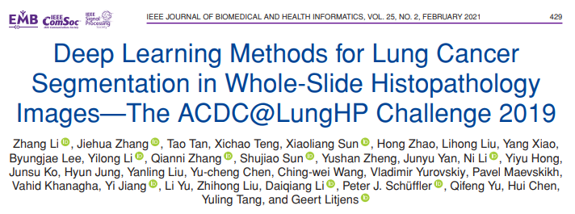
IF=6.937 (JCR 2020)
IF=14.919 (JCR 2020)
IF=10.048 (JCR 2020)
IF=8.545 (JCR 2020)
IF=5.772 (JCR 2020)

Slide 10
Evaluation Technology 驗證評核方法

Slide 11
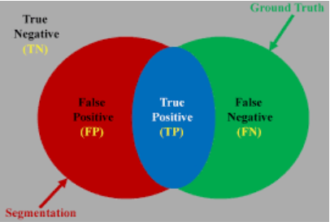
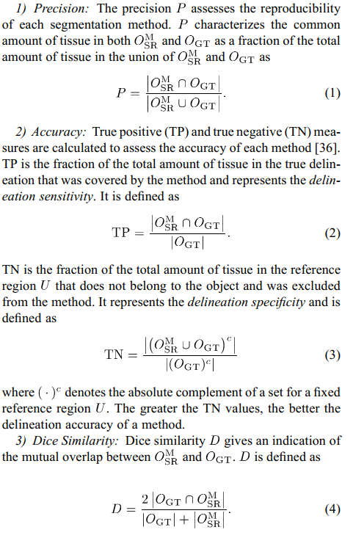
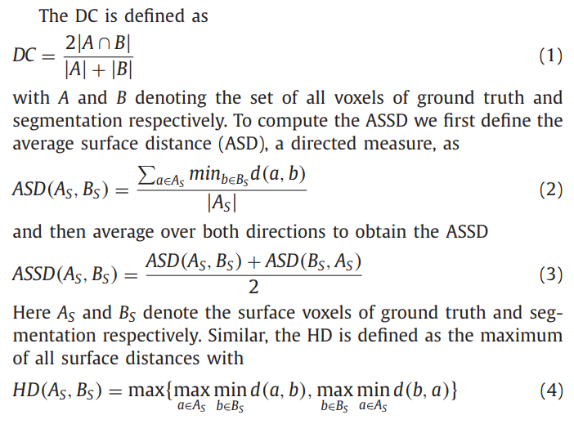
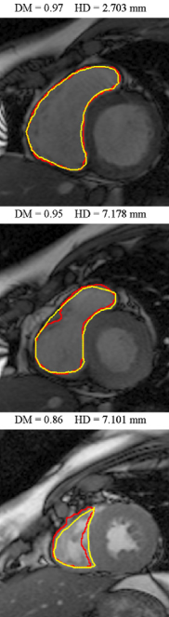
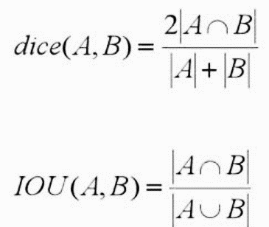
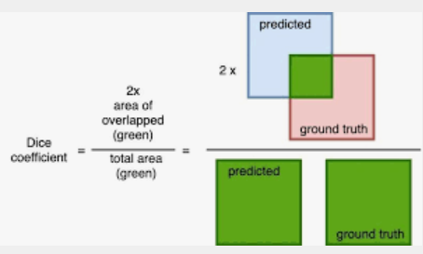
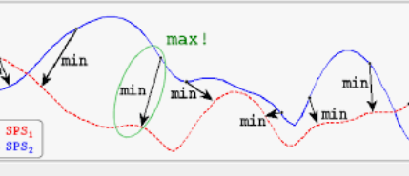
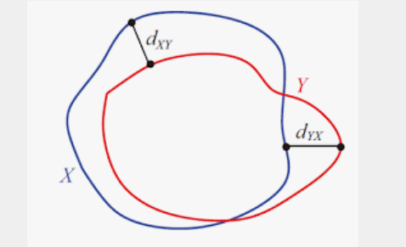
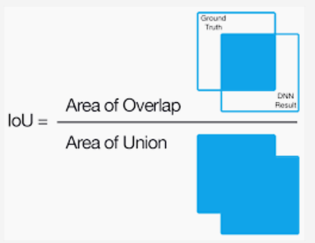
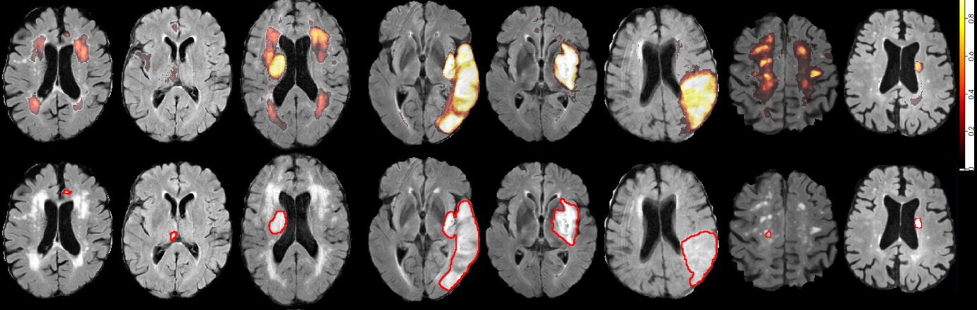
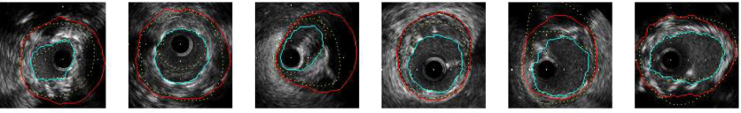
Region-Based Metrics
Distance-Based Metrics
Maximum Symmetric Contour Distance (MSD) / Hausdorff distance (HD): especially sensitive to outliers.
Average Symmetric Contour Distance (ASD)
Root Mean Square Symmetric Contour Distance (RMSD): similar to the ASD but large distance differences between contours will return a greater value, penalizing large deviations from the ground truth.

Slide 12
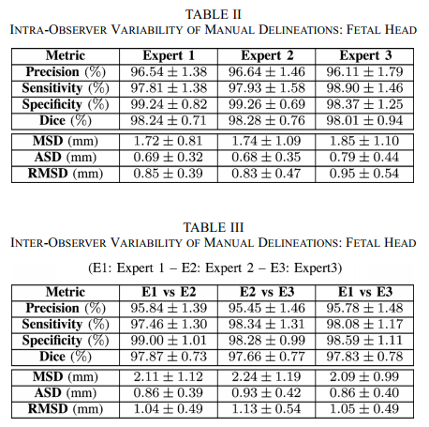
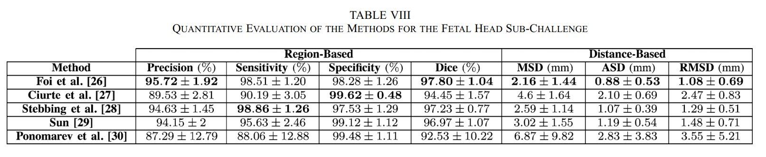
A total of three experts, with different degrees of expertise, participated in defining the fetal head sub-challenge ground truth, by fitting an ellipse to the object of interest twice on each image, as well as performing the corresponding standard clinical measurements (HC, BPD, OFD). The experts had the following level of expertise. • Expert 1: Clinician (fetal medicine specialist) with 10 year postgraduate experience in fetal US scans. • Expert 2: Clinician (obstetrician) with two years experience in fetal US scans. • Expert 3: Engineer with 1 year of experience. The intra-expert variability is similar for all three experts. Although there were minor differences reflecting the levels of experience, these were not statistically significant. Expert 3, who was the less experienced, obtained slightly inferior results than the other two experts, but still very close.
A low standard deviation indicates a higher reproducibility.

Slide 13
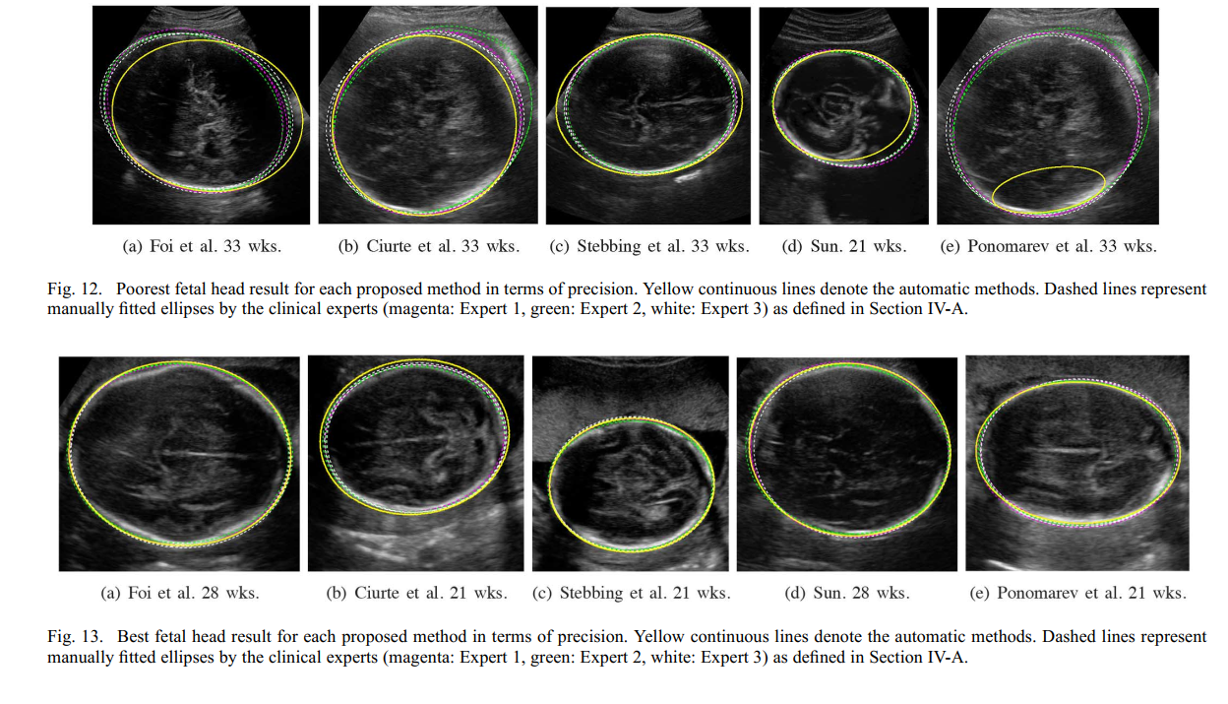

Slide 14
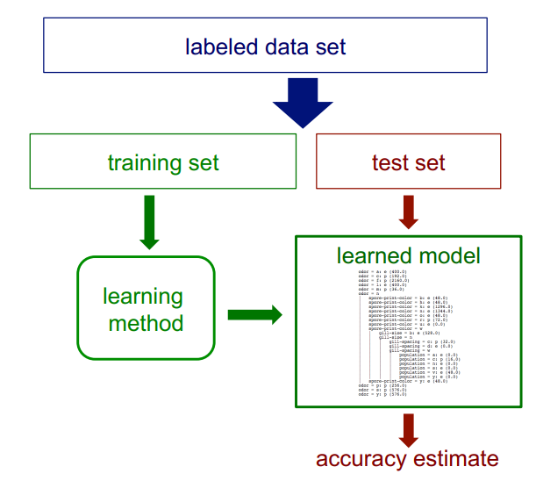
Test sets How can we get an unbiased estimate of the accuracy of a learned model?

Slide 15
Test sets How can we get an unbiased estimate of the accuracy of a learned model?
• when learning a model, you should pretend that you don’t have the test data yet (it is “in the mail”)* • if the test-set labels influence the learned model in any way, accuracy estimates will be biased
* In some applications it is reasonable to assume that you have access to the feature vector (i.e. x) but not the y part of each test instance.

Slide 16
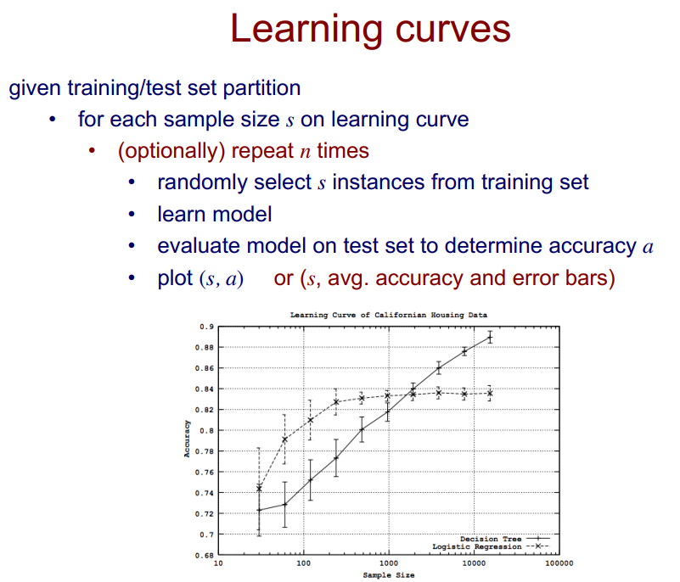

Slide 17
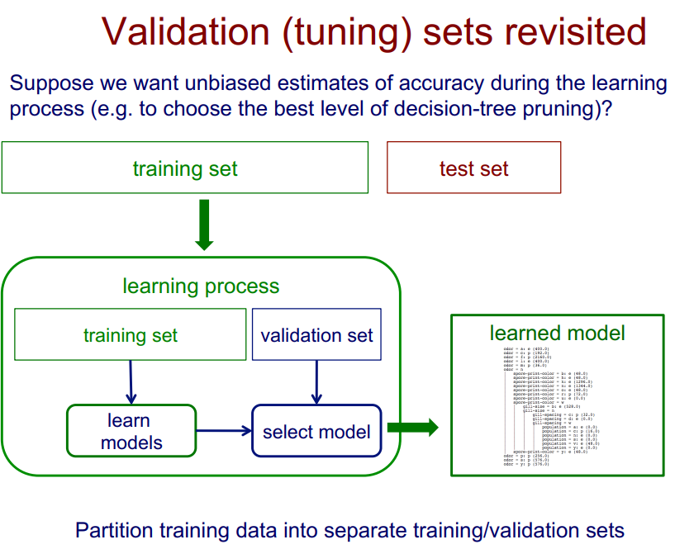

Slide 18
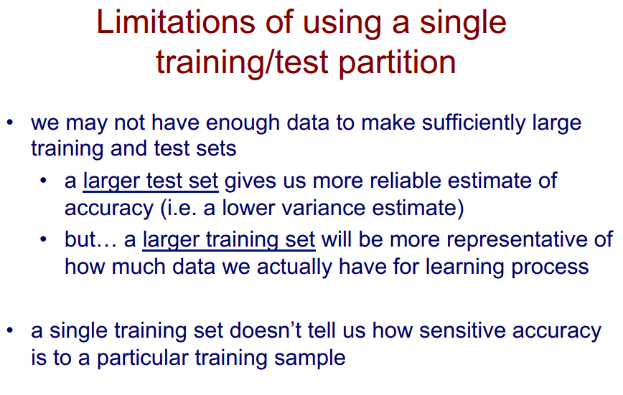

Slide 19


Slide 20


Slide 21


Slide 22


Slide 23


Slide 24

Model Selection

Slide 25


Slide 26



Slide 27


Slide 28


Slide 29






Slide 30
ROC Curve(Receiver Operating Characteristic Curve)
在一個二分類模型中，我們的模型通常不會直接輸出0,1直接預測出分類，而是對每個分類輸出一個機率，例如加上softmax對各分類輸出機率，這樣讓我們能夠自己設定一個門檻(threshold)來決定機率大於多少時我們判定為正樣本，反之為負樣本。而 ROC Curves 和 PR Curves 可以幫助我們分析這樣的 probabilistic forecast.
Skill
ROC 曲線以 FPR 為 X 軸，TPR為 Y 軸，每一個點代表設定不同的門檻值所得到的不同的 FPR 及 TPR ，最後繪製成一條曲線。
TPR
No-skill
Skill —模型是 skillful，表示模型更能夠給定一個正樣本更高的機率，反之負樣本更低的機率
No-Skill — 沒有 skill 的模型，在任何的門檻下，給正負樣本的機率都為0.5，從模型中無法獲得任何有用資訊，在 ROC 曲線中以左下到右上的對角線表示
FPR

Slide 31


ROC Curve
偽陽性率：FPR (False Positive Rate)
FPR = 1-特異度 ; 特異度(specificity)意指正確判斷出負樣本，故特異度越高、FPR越低，模型越能夠正確判斷負樣本、表現越好
真陽性率：TPR (True Positive Rate)
TPR又稱為敏感度(Sensitivity)，它也是我們熟知的召回率(Recall)，也就是正確判斷出正樣本，故TPR越高則模型越能夠正確判斷正樣本、表現越好

Slide 32


PR Curve(Precision-Recall Curves)
PR 曲線以 Recall 為 X 軸，Precision 為 Y 軸，每一個點代表設定不同的門檻值所得到的不同的 Recall 及 Precision ，最後繪製成一條曲線。
Recall 及 Precision 都適合用於類別不平均的資料集
因為在算式中並沒有考慮 True Negatives (TN) ，只專注於正確判斷正樣本，因此，就算資料集中負樣本的數目遠大於正樣本，Recall 及 Precision仍是有效的參考指標。
ROC Curves 適合類別平均的情況，而 PR Curves 適合於類別不平均的情況

Slide 33
AI in Medical Image Analysis 應用範例

Slide 34






Wang et al. (2021) Artificial Intelligence-Assisted Fast Screening Cervical High Grade Squamous Intraepithelial Lesion and Squamous Cell Carcinoma Diagnosis and Treatment Planning, Scientific Reports 11:16244, 1-14 (JCR 2020, MULTIDISCIPLINARY SCIENCES 17/73, IF=4.379)
Cervical Cancer
F1-score is defined as the harmonic mean of the precision (Pr) and the recall (Re; sensitivity)

Slide 35




Lin et al. (2021) Deep learning fast screening approach on cytological whole slides for thyroid cancer diagnosis, Cancers 13(15), 3891, 1-13 (JCR 2020, Oncology 51 / 242, IF= 6.639)

Slide 36

Segmentation – Thyroid Cancer

Slide 37








Med AI - Detection

Slide 38



Confusion Matrix

Slide 39


Confusion Matrix

Slide 40


Bone Marrow Cell Detection & Classification

Slide 41



Bone Marrow Cell Detection & Classification

Slide 42




AI applications in medical image analysis - Classification
Compare precision medicine methods in thyroid cancer diagnosis using tissue microarrays

Slide 43
Review Experience 審查經驗分享

Slide 44
Evaluate model usability
Data variations on data preparation (staining methods, human factor), digitalization (different device / brand, equipment setups)
Generalization error
Bias error
Training set
Testing Set
(Hospital 1)
Testing Set
(Hospital 2)
Testing Set
(Hospital 3)
Training (70%), Testing (30%)
Training (70%), Validation (10%), Testing (20%)
N-fold Cross Validation (10-fold, 5-fold, 3-fold)
What’s the differences?

Slide 45

Data
Source
IRB (文件)
Information Consent
Distribution
Patient selection / conditions
Equipment and setup
Image Resolution in pixels and physical size

Slide 46

Data Distribution
Class distribution
Positive, Negative: (95, 5), (60, 40), (900, 100)
Cervical Cancer: Women with HSIL, for whom the risk of cancer is high, are immediately referred for colposcopy and, if the lesion is confirmed, surgery is required to remove the tumor.

Slide 47
Quality of reference standard / Labels
Blood testing results , existing testing tools, testing on other data acceptable in clinical practice
Other data: alignment of data
Manual annotations
The experts had the following level of expertise. • Expert 1: Clinician (fetal medicine specialist) with 10 year postgraduate experience in fetal US scans. • Expert 2: Clinician (obstetrician) with two years experience in fetal US scans. • Expert 3: Trained Engineer with 1 year of experience.
https://www.youtube.com/watch?v=0Uc6-s_ClIg&ab_channel=ProfChing-WeiWang
Reference standard
The intra-expert variability is similar for all three experts. Although there were minor differences reflecting the levels of experience, these were not statistically significant. Expert 3, who was the less experienced, obtained slightly inferior results than the other two experts, but still very close.
A low standard deviation indicates a higher reproducibility.

Slide 48


Related publications 回溯性研究 / 發表
Quality of the papers: check impact factor
SCI indexed, JCR database => impact factor > 2, rank > 50% => the studies are validated by careful reviewing systems.

Slide 49




Journal’s performance

Slide 50

Claims
Check the evaluation carefully w.r.t. the claims
N claims but only few appear on the papers.
Low performance on the papers
Signatures (MDs, Engineers on docs)
IRB Documents
Papers, reports
Generalizability (Testing sets??)

Slide 51


Claim

Slide 52
Q & A

